Slide 1
US Census
Its Income Association and
Related Issues
Chuong Tran, Tim Holland
April 18, 2017

Slide 2
Objective
What is the most important factor/feature that contributes to an income earned by a person?
Does marital status/education matter in terms of income earned?
Predict an income earned
Does native country or country of origin matter in terms of income earned? (NOT really!)
Notes:
We will ignore the native country question since it really does not support or help to answer the big picture questions.
If education/marital status matter, then predict whether a person will earn more or less than 50k based on that.
Missing data for workclass and occupation and occupation are too broad with many jobs -> harder to assign values

Slide 3
Decision Tree
Logistic Regression
Random Forests
Discuss how data is being represented in a current state
Discuss the findings, challenges and any interesting results
Data Exploration
Data Processing
Drawback
Conclusion
Methods & Evaluations
Discuss how data is being processed before use
Discuss some limitations and challenges facing

Slide 4
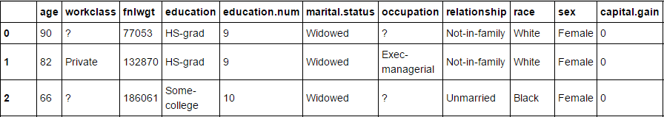
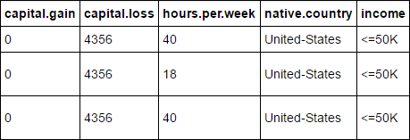
Data Exploration
1994 Census bureau database by Ronny Kohavi and Barry Becker
Mixture of continuous (ie. age, education numbers) and discrete (categorical: race, sex, etc.) features
Binary outcome: income feature (>50K or <=50K)
Total number of samples: 32561 with 15 features

Slide 5
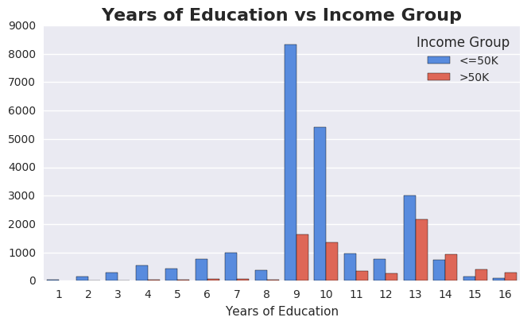
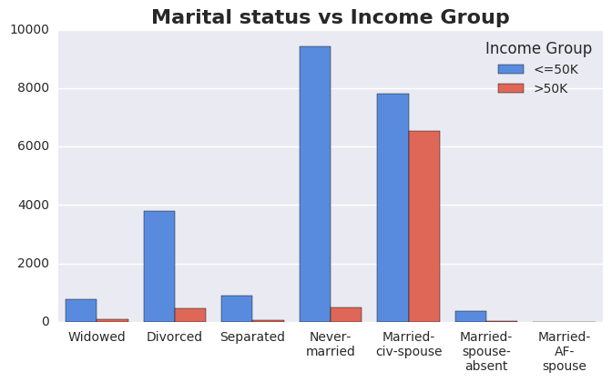
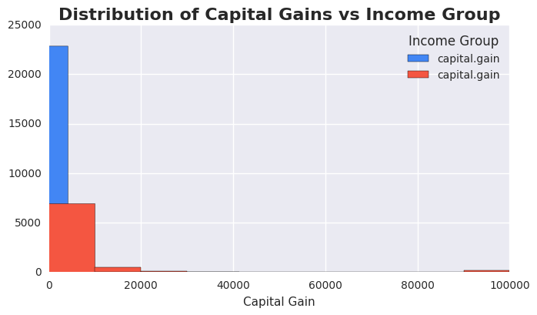
Data Exploration (cont)
Notes:
9 - HS-grad
13 - Bachelor

Slide 6
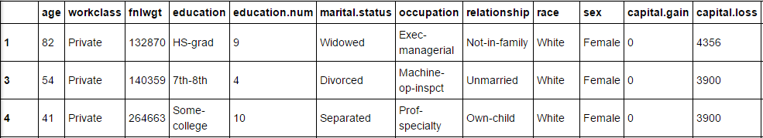
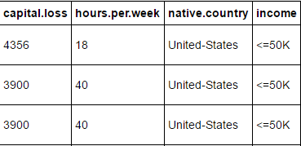
Data Processing
Remove instances with missing data completely (NaN, ?) - from 32561 to 30718
Insignificant data loss, irrelevant features and unmeaningful
Notes:
Since missing data is not only for one feature but for a couple of features (some are not relevant) in a row. Thus it’s completely useless to use that row

Slide 7
Data Processing (cont)
Use SMOTE to perform oversampling to create an equal number of instances that have an income of <=50k and an income of >50k.
New total number of instances = 46136
Income
<=50K 23068 >50K 7650
Income
<=50K 23068 >50K 23068
Notes:
SMOTE create new minority class to balance out data

Slide 8
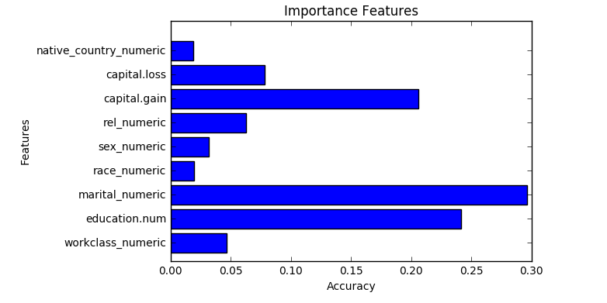
Data Processing (cont)
Carefully analyzing data before processing (feature selection)
Assign categorical features with integer numbers (ie. Male: 0, Female: 1, <=50K: 0, >50K: 1)
Extra Trees Classifier
Compute the relative importance of each feature
Notes:
Extra Tree (ensemble of DT) compute the relative importance of each attribute

Slide 9
Methods
Evaluations
Classification Report
Precision, recall, f1-score
Confusion Matrix
K-Fold Cross-Validation
K-Nearest Neighbor Classifier
Random Forests
Logistic Regression
Decision Tree

Slide 10
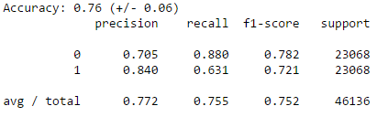
K-Nearest Neighbor Classifier
Exhaustive search of k values to determine the optimal value
k = 7

Slide 11
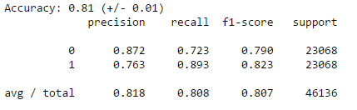
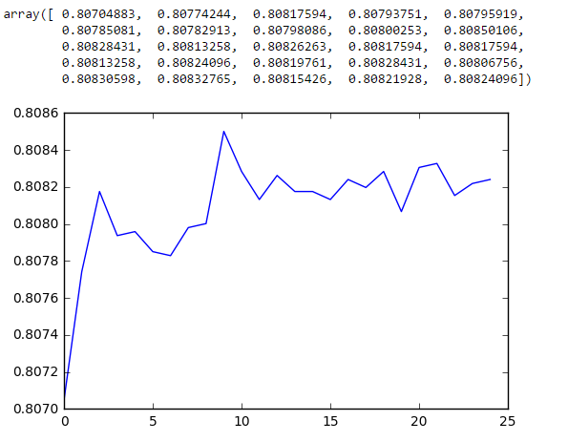
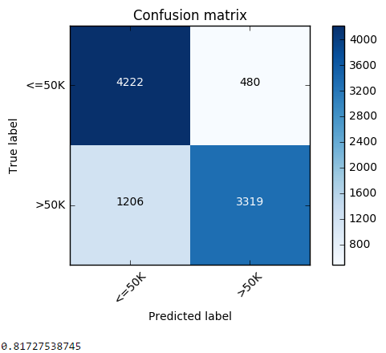
Random Forests
Notes:
X: trees, Y: accuracy

Slide 12
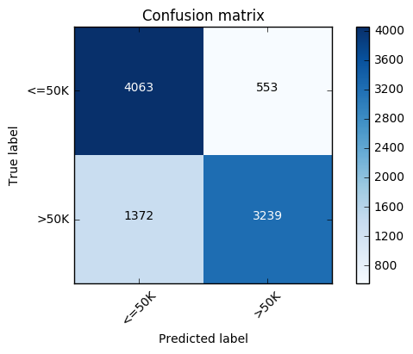

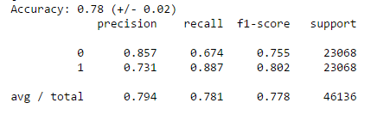
Logistic Regression

Slide 13
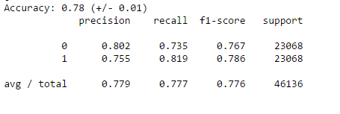
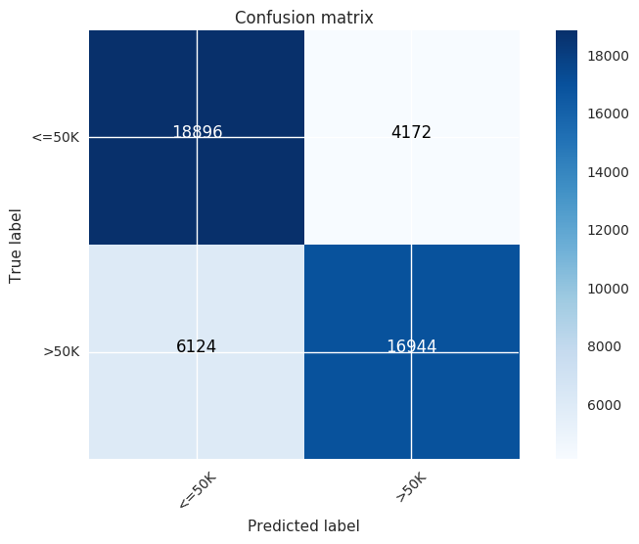
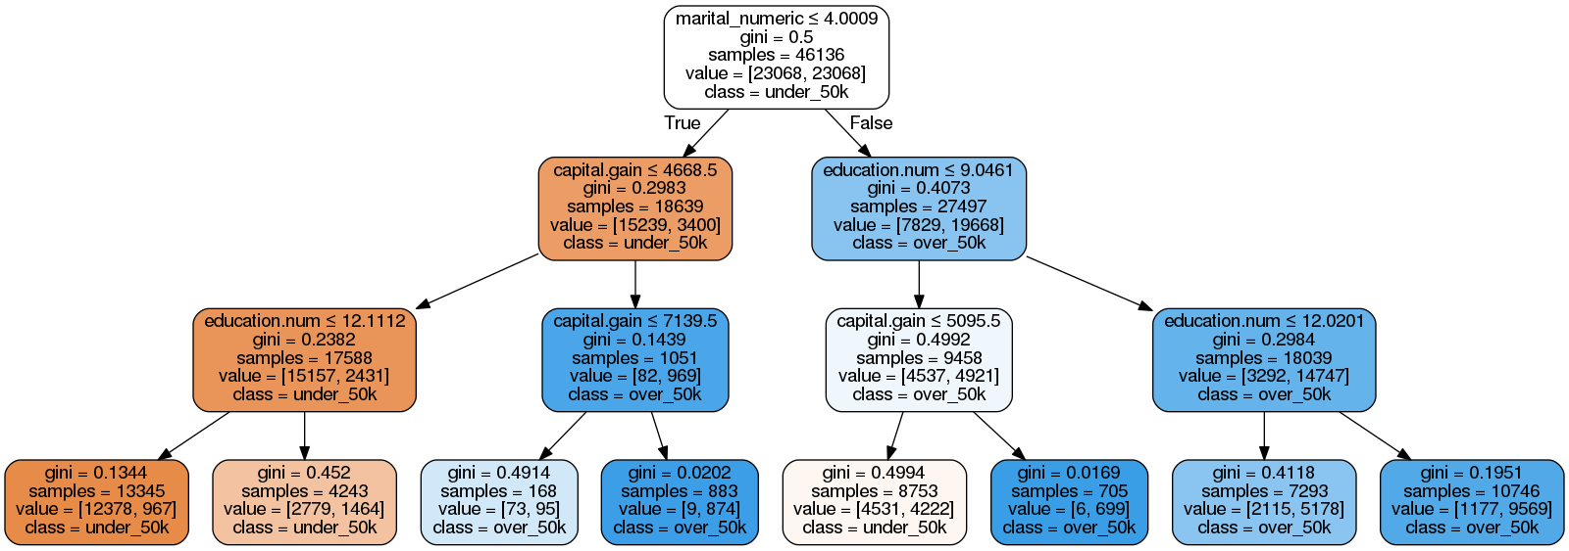
Decision Tree

Slide 14
Applications
Tax auditing, loan applications, or court proceedings to determine if people are potentially misrepresenting income/wealth
Immigration policies centered around income requirements
Financial planning for unemployed / yet to be employed individuals
City growth planning

Slide 15
Conclusion
Three most important factors that determines an income earned by a person: marital status, years of education, and capital gain
Accuracy for each model is consistent even though it is not high
Models can be used for future datasets and/or to help to predict an income for people based on their current status
Future Challenges:
Utilize richer data sources and take different approaches with the dataset
Feature selection approach: Recursive Feature Elimination (RFE)
Capital gain might not be relevant, and can dig deeper into additional features
Couple with other datasets to gain more insight and interesting results

Slide 16
References
Ronny Kohavi and Barry Becker, UCI Machine Learning Repository [http://archive.ics.uci.edu/ml]. Irvine, CA: University of California, School of Information and Computer Science, 1994.
Ronny Kohavi, "Scaling Up the Accuracy of Naive-Bayes Classifiers: a Decision-Tree Hybrid", Proceedings of the Second International Conference on Knowledge Discovery and Data Mining, 1996.

